Slide 1
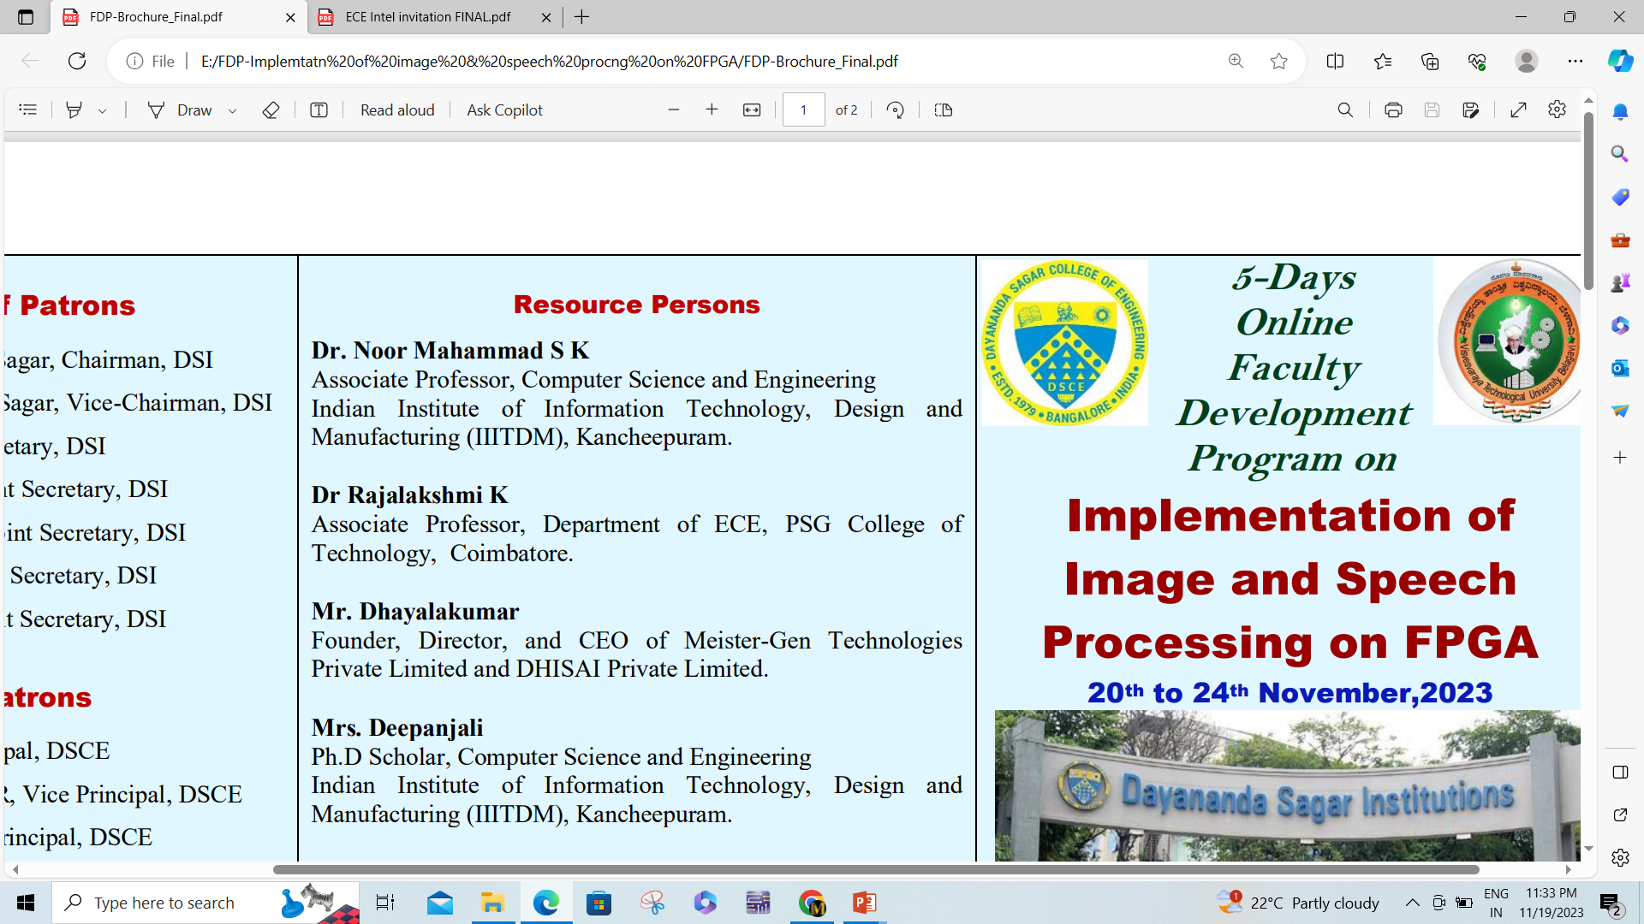
DAYANANDA SAGAR COLLEGE OF ENGINEERING Department of Electronics and Communication Engineering
Reconfigurable Intelligent surfaces for 6G Mobile Networks
Priyanshu
USN : 1DS21EC153
8th Semester
Course Name: Technical Seminar
Course Code:21EC81
Date / Time of Technical Seminar
Section Coordinator: M Padmavati Guided by: Dr. Manasa RK Asst.Prof Asst.Prof

Slide 2
Contents
Introduction
Objectives
Literature Review / Background (Minimum five papers should be referred)
Methodology / Approach
Design / Implementation
Results & Discussion
Applications
Advantages & Limitations
Conclusion

Slide 3
INTRODUCTION
6G is the next generation of wireless networks, aiming to provide faster speeds, ultra-low latency, and smarter connectivity for applications like IoT, AR/VR, autonomous vehicles, and smart cities.
Reconfigurable Intelligent Surfaces (RIS) are a new technology that can control how wireless signals move through the environment by reflecting or redirecting them intelligently.
Unlike traditional methods RIS can improve signal coverage and quality without consuming much power or requiring complex infrastructure.
It is a passive system, meaning it doesn’t amplify the signal or need continuous power like relays or antennas — making it ideal for energy-saving communication.
RIS is useful in areas with weak signals, especially where buildings or other obstacles block direct signal paths (non-line-of-sight or NLOS conditions).
The main idea behind using RIS in 6G is to make wireless communication more efficient, cheaper, and better suited for dense urban environments or remote areas

Slide 4
OBJECTIVES
Understand the working principle of Reconfigurable Intelligent Surfaces (RIS) and how they can improve wireless communication in 6G networks.
To study the hardware components of RIS, including unit cells, control circuits, and Liquid Crystal (LC)-based designs.
To explore the software side of RIS, such as control algorithms, beamforming techniques, and integration with AI or ML for signal optimization.
To investigate the real-world deployment challenges of RIS, like placement, environmental adaptation, and control signal requirements.
To compare RIS with traditional technologies like active relays in terms of power consumption, cost, and scalability.
To propose future directions for RIS, including standardization, AI integration, and applications in smart cities, IoT, and energy-efficient networks.

Slide 5
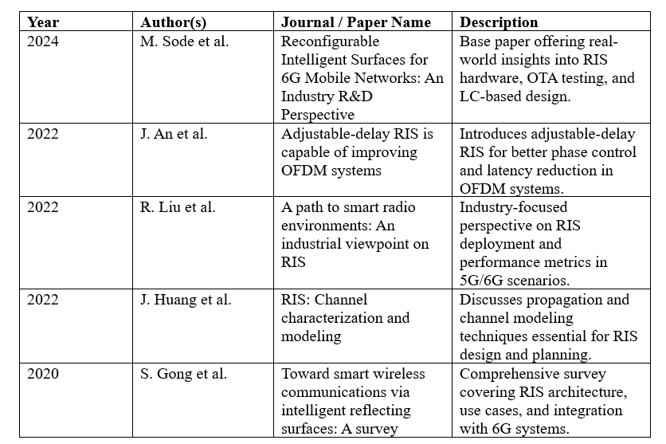
LITERATURE REVIEW

Slide 6
METHODOLOGY
l Design and Testing of RIS Hardware: A prototype RIS panel was developed using Liquid Crystal (LC) technology, which allows the surface to reflect wireless signals at different angles by changing its phase.
Control Circuit Implementation: A control system was built using FPGA (Field Programmable Gate Array) and analog circuits to adjust the voltage across the RIS elements, helping them control signal direction.
Simulation of Communication Scenarios: A software tool called QuaDRiGa was used to simulate real-world wireless communication environments with and without RIS to see how much performance improves.
Over-the-Air (OTA) Testing: The RIS setup was tested in controlled environments like anechoic chambers (rooms without echoes) to measure how well it reflects signals in different directions.
Performance Evaluation: The reflected signal’s strength, direction, and power usage were carefully measured to understand how effective the RIS is compared to traditional methods like relays.

Slide 7
IMPLEMENTATION
A Liquid Crystal-based RIS panel was designed, where each small element (unit cell) can change how it reflects wireless signals by adjusting the phase.
An FPGA (Field Programmable Gate Array) was used to send control signals to the RIS, allowing real-time adjustment of how the surface reflects signals.
A control circuit board was connected between the FPGA and the RIS panel to convert digital signals into voltages needed to tune the RIS elements.
A low-power DC supply was used to power the RIS hardware and control system, keeping energy consumption minimal.
Signals from the transmitter were directed to the RIS, which then reflected them toward the receiver by adjusting the angles of reflection.
A feedback link from the receiver helped the system adjust the RIS configuration to maintain strong signal quality, even if the user moved.

Slide 8
RESULTS & DISCUSSION
The RIS improved signal strength by 20–30% in areas where the user couldn’t directly see the base station (non-line-of-sight areas).
Compared to traditional relays, RIS used about 90% less power, making it great for energy-saving and eco-friendly communication.
The RIS system was able to focus the signal (beamforming) toward the user by changing how the surface reflected the signal.
When AI and machine learning were used to control the RIS, the system performed almost as well as more expensive phased array antennas.
Simulations using modeling tools showed that RIS can be planned and installed in a smart way to improve coverage in different places.

Slide 9
APPLICATIONS
Used to improve signal inside buildings like malls and offices.
Helps signals go around corners in crowded city areas.
Saves energy, making networks more eco-friendly.
Supports smart devices like sensors in homes and industries.
Keeps mobile users connected by adjusting signal direction.
Works well with high-frequency signals that can't pass through walls.

Slide 10
ADVANTAGES AND LIMITATIONS
Uses very little power compared to other technologies.
Can improve signal strength in hard-to-reach areas.
Works well in both indoor and outdoor environments.
Needs careful placement to work effectively.
Controlling it in real time can be complex.
Still a new technology — not fully standardized yet.

Slide 11
CONCLUSION
RIS is a promising technology for improving wireless communication in 6G networks.
It offers a smart way to reflect and control signals without using much power.
LC-based RIS panels are transparent, low-cost, and suitable for real-world use.
RIS improves coverage in areas where direct signals are blocked.
Compared to traditional systems, it is more energy-efficient and eco-friendly.
Simulation and testing show that RIS can work well in both indoor and outdoor environments.
With further development and standardization, RIS can play a major role in future communication systems.

